Slide 1
Collaborative Grant Writing as the Lead Organization

Slide 2
Intro & Experience
Maggie Bonjean
14 years working in small, nonprofit organizations
6 years in food banks
M.A. Urban Planning and Policy, University of Illinois at Chicago
Specialization in Community Development
Heather Ellis
15 years writing of grants for variety of
nonprofit organizations
5 years at Oregon Food Bank
Masters of Business Administration
President of local GPA Chapter
Notes:
Heather has worked with social services, arts, education, mental health, and healthcare organizations.
We have worked together on multiple collaborative proposals at Oregon Food Bank with under sourced organizations. Oregon Food Bank has over 1,200 partners to whom we provide food assistance and we regularly hold grant trainings for those in the Portland metropolitan area.
OFB works with over 1,200 partner agencies programs encourage collaborations. OFB’s grants team focuses on partnerships with smaller organizations that have lower capacity. We occasionally work on collaborative proposals with larger organizations, but usually with an annual budget of over $60 million – we are the larger organization in the partnership.

Slide 3
Collaborative Grant Writing
"None of us, including me, ever do great things. But we can all do small things, with great love, and together we can do something wonderful." – Mother Teresa

Slide 4
Course Overview
Collaborative grant writing and partnerships introduction
Preparing the grant application
Post grant partnership management
Mentoring and other best practices
Notes:
-we will be focusing on collaborations between two organizations where your organization is functioning as the lead partner or grant applicant, with a special focus on building the capacity of smaller organizations. However, the information can easily be applied to consultants working with small organizations as well as collaborative grant projects within your own organization with other grant writers or program staff
-Will discuss how to establish a healthy partnerships
-Prepare the application and managing the grant administration with the partner
-mentoring and training and other best practices

Slide 5
GPCI Alignment
Effective program and project design and development
Organizational Development
Post-award grant management
Professionalism of grant developers
Research, identify, and match funding sources
Relationships between fund-seeking and recipient organizations and funders
Notes:
Importance of project management and communication tactics will be described. Also, evaluation on whether the partnership is a good fit for the organization and/or grant application
Helping other organizations (frequently smaller with less capacity) develop their organization(s) in order to be grant ready
Working with partners on reporting as the lead applicant
Describe appropriate procedures for working with and including the other organization(s) in application and program design
Working with partners to identify and evaluate which organization should be the lead in new opportunities once the original grant application and partnership has been established.
Maintaining the complex relationship between being the lead organization who works directly with the funder and collaborative partner(s) will be addressed.

Slide 6
Question:
What does a “true” partnership among non-profits look like?

Slide 7
Partnership Best Practices
Focus on long-term partnerships
Mutually beneficial
Joint ownership and implementation
Quantifiable exchange of
substantial value
Notes:
Focus on long term partnerships – not just for the specific project or grant application
Project that all partners are benefitting from, although most likely in varying ways and degrees
Actively and jointly own and implement the project
Quantifiable exchange of substantial value – not just a casual agreement to make referrals or
shared budget

Slide 8
Relationship Drivers -- Non-Profit First Model
Partnership
Strengthens Larger Community
Shared Resources
Mutual Benefits, Reciprocity
Contractual Nature
Mission and Impact

Slide 9
Partnership Case Study
Oregon Food Bank and Mudbone Grown partner to provide the Beginning Farmers of Color Program, a workforce development program in agricultural food production.
Oregon Food Bank is a leader in the local and national movement to address the root causes of hunger.
Mudbone Grown is a family farm enterprise with expertise in building culturally specific food production and community economic development models for communities of color.

Slide 10
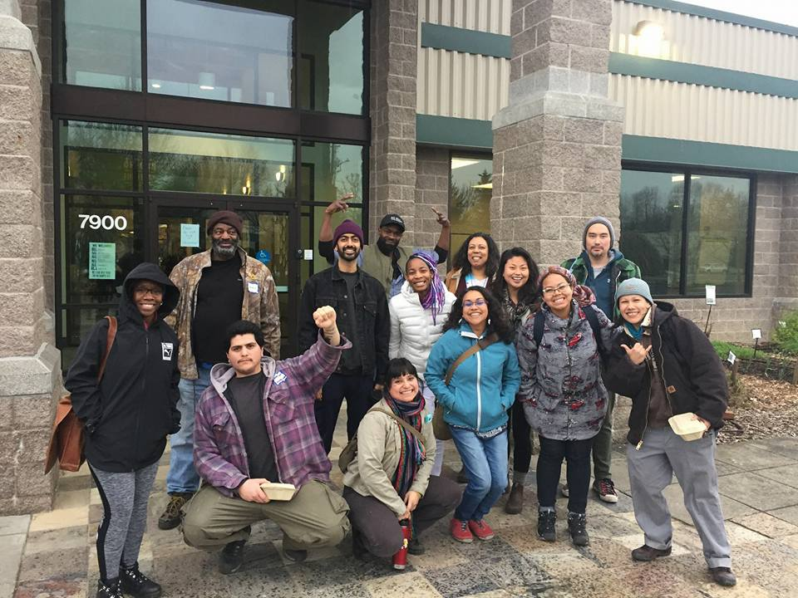
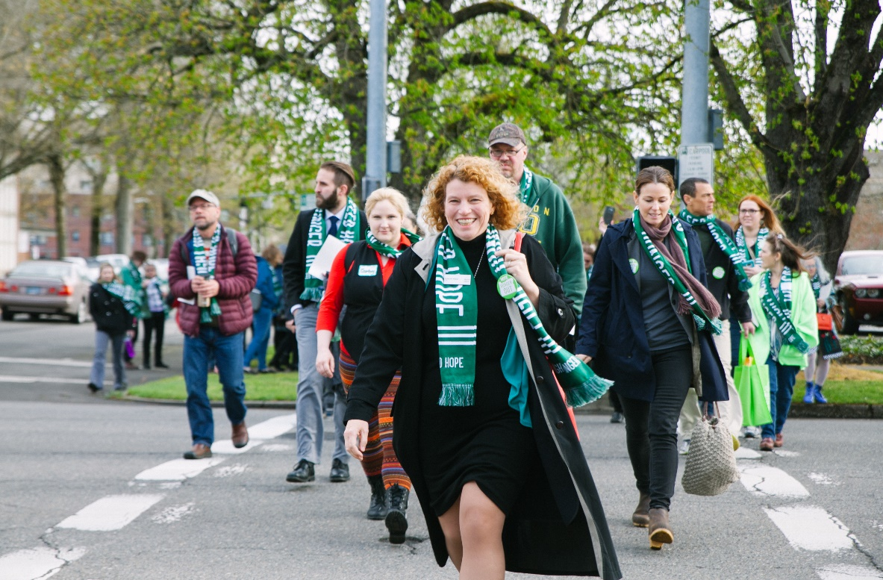
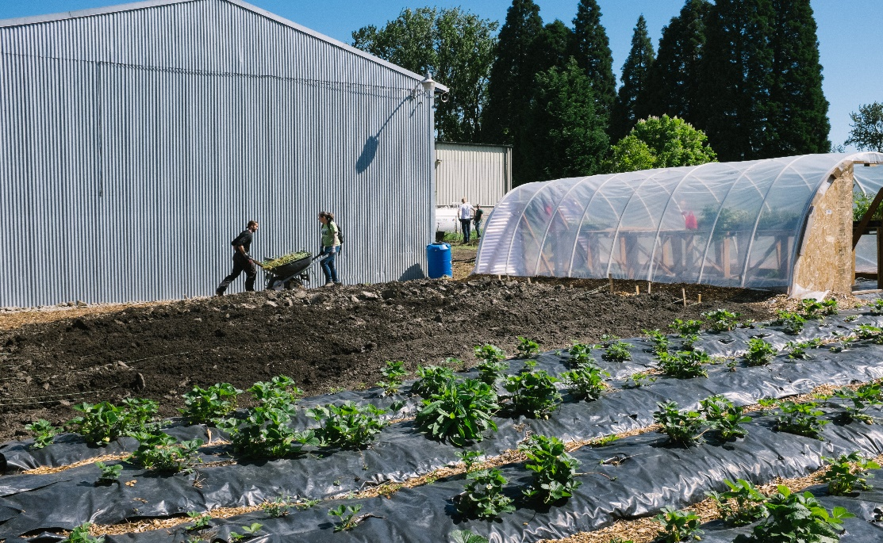

Slide 11
Assets
Oregon Food Bank – Lead Agency
Expertise in food production
Strong financial management systems
Fundraising capacity
Mudbone Grown – Partner Agency
Expertise in community based programs
Established community partnerships
Meeting an established need in the community

Slide 12
Relationship Drivers
Contractual – Federal Grant, MOU
Strengthens larger community – Commitment to bringing resources to underserved, vulnerable communities
Mission impact - Improving food security for the community through the production of food and workforce development
Mutual benefit – Financial resources, visibility, capacity
Reciprocity – Deep commitment to the partnership with all its successes and challenges.

Slide 13
Grant challenges when working with Smaller Organizations
Less resources
Less developed systems for fundraising and
program development
Might be in need of a fiscal sponsor
May be less responsive with
grant requests
Notes:
-potentially the fundraisers are the same people as the program managers
-might need to do some basic fundraising education, especially around grants – need to make sure that we don’t apply to all grant opportunities
-talk about grant prioritization ( provide grant matrix as material?)
-provide them with resources and basic training
-need to ensure the partnership is helping them develop there organization and expand as well as providing a benefit to the lead organization
-might need to follow up more often to get information (ensure you have both their email & phone number)

Slide 14
Establish Partnership
Finding a new partner
Understanding of strengths of partnering organizations
Involve senior management
Shared goals
Regular and Open Communication
Formal agreement such as an MOU
Notes:
-look to current partnerships to find new partners that meet your specification, we were looking for a culturally specific partner
-try out smaller projects first and can gradually increase
-Try to start building the relationships and discussing the possibilities before grant opportunity as this will lead to the best possible outcomes, although grant applications often do serve as motivators to deepen partnerships and programs
-discuss shared vision and potential for partnering
-our program staff met with partner as frequently as once per week
-Be be open about conflicts and encourage partner to also do so
-ensure the partner feels that they are able to provide info and that they have equal input
-clear expectations in the MOU, separate the money from the MOU (that’s in the grant agreement); -MOA MOU/MOA can lay out what services each partner is providing, process for joint decision-making and communication, what resources – including funds – will be shared – and then have the leader of each organization sign

Slide 15
Writing the Grant Application Overview
Kick Off Meeting
Defining Roles
Create a Timeline
Project Design
Budget
Review
Application Submission
Notes:
-Will go over these in detail in the next several slides

Slide 16
Kick Off Meeting
Evaluate RFP in detail
Decide on questions for funder
Start on Letters of support early!
Define roles
Notes:
-Read RFP through ahead of time and highlight sections
-Try to get as many questions as needed for the funder in the first email/phone call – decide on one person from the lead organization to be the contact with the funder
-letters of support often take the longest, ensure partner understands too that letters of support should detail what the partner is doing for the project

Slide 17
Defining Roles
Decide on a Project Manager
Submitting the Grant
Narrative Sections
Lead Organization Program Contact
Main Contact with Funder
Budget
Reviewers
Notes:
-OFB recommends assigning a project manager
-pm is responsible for entire application & ensuring all elements of the application are complete, can also have specific duties like the budget narrative
-pm should be from the lead organization
-pm/lead organization will usually be the one submitting the application
-project manager is responsible for letting everyone else know what information is needed & when it is needed
-for our projects, one grant professional is the project manager & the other focuses just on the narrative section
-find out the strengths of the team and consider this when assigning tasks
-also can break out sections of the narrative and assign
-Establishing clear lines of communication and responsibility
-ask the best times for contacts and meetings
-assign responsibility for the budget
-decide who will review the application and in what order

Slide 18
Create a Timeline
Can be a simple Word Document
Other Potential Resources
Project Management: Basecamp, Freedcamp, Tom’s Planner
Google Docs
Excel
Ensure timeline is shared
Accountability
Notes:
-Can be very simple (see sample), or can use a project management software to assign roles and due dates
-Discuss Project Management Resource document
-Ensure timeline is shared both at meetings and through email
-make sure and ask each person when they think they can accomplish a task or assign a date - but ask if it seems reasonable to them

Slide 19
Question
Can anyone identify a project management resource not on the list?
Notes:
-If no one answers, ask them to talk about how they have used a particular project management resource.

Slide 20
Project Design
Likely will need a project design/narrative meeting
Innovation vs. Chasing Money
Keep program staff on track
Collaborative Needs Statement
Objectives/Outputs
Outcomes
Evaluation Plan
Notes:
-often grant writers have to get involved in project design
-must strike a balance for organizations to use grants to be innovative and “chasing money”
-grant writers might need to be in these discussions to help facilitate them & get info for the narrative
-also to remind them of the guidelines and focus of the grant application
-best time to develop the collaborative needs statement
-recording this meeting can be very helpful & then go back and listen to later as opposed to taking notes
-recording also allows you to focus on listening and building the relationship with the partner
-make sure that the project has outcomes, objectives, and a solid evaluation plan
-Define primary objectives/outputs - # of people served, # of classes, etc.
-Define outcomes – primary purpose of program & skills participants will be gaining. Best to make these measurable – such as 90% will approve their cooking skills
-Evaluation – measure the program’s success & if the outputs and outcomes have been achieved
-need to define who is tracking this (usually the led organization will be the one primarily responsible) – for larger government grants, great to have an outside org. to have
To do an evaluation

Slide 21
Simple Project Budget

Slide 22
Organizational Total Project Budget

Slide 23
Budget
Create a preliminary simple budget
Grant specific budget
Notes:
First budget
-both organizations need to think about all of the potential expenses for the project
-may need to remind them of things like all the potential supplies
Budget for specific grant application
-focus on the grant application requirements and get specifics
-person responsible for the budget should review in detail and then go through questions with rest of the team

Slide 24
Final Steps for Grant Application
Grant Review
Send out final version
Notes:
-ensure program staff are able to edit
-request content edits & copy writing edits
-if time, give to one person at a time to edit so there are not duplicate edits
-google docs is appealing for Word docs – but it can mess up the formatting
-if not, ask that everyone email others with changes as soon as they are made
-send out final version of the application to all partners

Slide 25
Maintaining the Partnership
Let partnership evolve
Build trust over time
Lead organization as funder contact
Continue open communication
Share all proposals/reports
Regular Meetings
Provide ongoing mentorship in grants
Notes:
Be willing to let the partnership evolve and be dynamic – flexibility, do not be too focused on specific delivery points
Over time they will be more open to letting you know about gaps in their skills set & training can become easier
-be the main contact with the funder (make sure the funder is only communicating regularly on the grant with the organization who submitted the application)
Communicate with the funder as needed & if the partner and/or program staff have too many questions – such as once a week – encourage them to combine their questions or evaluate whether these are really necessary questions. Can also suggest a conference call with the funder/lead organization/partner
As the lead organization “own” the funder relationship but also help the partner develop their own relationship with funder as needed.
For foundations this can be done by inviting the partner to events with the funder such as site visits or cultivation events
- I request from OFB program staff who than requests info from partner
-make sure they feel comfortable reaching out to both program and fundraising staff
-best if they have just one main contact though for information requests
-Also important that the partner has a strong relationship with the CEO of your organization
-ensure they know about all proposals involving shared ensure everyone has all the reporting templates & deadlines
programming
--offer to help partners develop grant proposals & other fundraising

Slide 26
Being a Mentor
Ask Questions and Listen carefully
Have Introductory Resources Ready
Focus on Relationship Building with partner
Notes:
OFB does quarterly training one-to-one sessions for our 1,200 partner agencies as grants “office hours”. We each work with each organization to help them address their specific needs
Hand-ons training like of foundation directory or other prospecting software is often very useful
Do not just start training them in the basics of grants
I’ve been given a grant proposal & just started editing without asking them the purpose of the proposal. It turned our to be more specific than I had believed & my edits didn’t make sense
Have a resources materials ready such as with basic info they can look at later
Can do demonstrations like Foundation Directory searches (research and grant reviews are our most common requests)
Focus on building a relationship with the individuals that you are training. This relationship can often lead to expanded partnerships within your organization.

Slide 27
Working with Others on Grants
Be open with grant knowledge and resources
Assigning roles/responsibilities
Be open and respectful in conflicts
No lateral edits
Notes:
-have a collaborative viewpoint & not competitive
-ensure roles are clearly defined at the start
-assign specific sections
-do not make lateral edits, be respectful of different styles of writing

Slide 28
Challenges
Gathering information from partners
Interactions with other staff and the lead org
Program design challenges
Funder & Equity issues
Notes:
-even with the support of the lead organization, smaller capacity organizations may not have as sophisticated systems and programs may fail to reach outcomes/objectives more often
-if a conflict arises, ensure that one staff member (the one with the strongest relationship) is the main contact with the org. Many organizations will have more than one person interacting with the other organization such as fundraising staff
Program design issues are best if worked out between program staff at the two organizations. It can help to have additional people in the meeting especially fundraising staff if a program design change will effect a current grant
You might encounter a funder that is not up to date on equity issues. We did have a funder which accidently offended one of our culturally responsive partners
Educate the funder carefully be explaining the specific issue
Protect the partnership over the funding opportunity/funder relationship
In the case, we still received the grant and the funder was very apologetic!

Slide 29
Question
What is one action step you are going to take?

Slide 30
Additonal Questions?
“Individually, we are one drop. Together, we are an ocean.” – Ryunosuke Satoro
Contact:
Maggie Bonjean: mbonjean@oregonfoodbank.org
Heather Ellis: hellis@oregonfoodbank.org
Notes:
Establishing partnership (get some info from Christine)
Writing the application & project design (mostly in this one)
-defining roles and expectations (some one should be project manager)
-create a timeline for tasks
-project design with partners
-working with other grant writer – clearly define roles & sections to be completed
Maintaining the partnership + providing support (in this one)
-providing grant advice and to partners (both Mudbone and Pas)
-mention challenge with funder & upsetting partner
-
Small org can help, bias – not be taken advantage of them
State learning goals

