Slide 1
Pro Tips & Tricks on Researching Your Next Winning Grant
Presenter: Erin Christensen, EdD

Slide 2
Thank you!
GPA Oregon and SW Washington Chapter Planning Committee, especially Laura Kim, Emmanuelle Jarmon, Darcie Spar, and Kris Ashley!

Slide 3
Order of Operations
Researching grant opportunities
Federal, State, County
Community and Private Foundations and Corporate Partners
Adventures in decision-making
Breakout room discussions: “What is the one thing you wish everyone knew about researching grant opportunities or the grant decision-making process?”
Big group discussion, Q&A, and close.

Slide 4
Poll the First.
Which grant research resources are you most interested in trying?

Slide 5
Finding Funding: Federal Agencies
Word of mouth
Agency Grant Pages/Newsletter sign-ups
NIH
SAMHSA (sign-up for grant announcements here)
HRSA
USDA (sign-up for updates here)
NSF (sign-up for email updates here)
There’s so many more!
Grants.gov (https://grants.gov/connect/manage-subscriptions/)
Federal Register Public Inspection Desk “Tomorrow’s Documents Today” (https://www.federalregister.gov/public-inspection/current)

Slide 6
Finding Funding: State, County, and Regional
Word of mouth
Oregon Department of Education
OregonBuys – procurement/contracting opportunities
Multnomah County
Clackamas County
Washington County
Central Oregon Health Data
Rural Health Information Hub

Slide 7
Finding Funding: Community/Private/Corporate Foundations
Word of mouth
Database access/subscription
List of Community Foundations in Oregon
Internet search and star
Request for Proposals (RFP) mailing lists (such as: https://philanthropynewsdigest.org/user/register/2?pnd_profile)
Reverse search
Funders in the wild

Slide 8
Poll the Second
Do you have a formal decision-making process in place to determine which grants to pursue?

Slide 9
Deciding to Apply or Not: Opportunity Circle
Opportunity
Match
New/Old Pals
Timing
Capacity
Sustainability

Slide 10
Deciding to Apply or Not: Decision Matrix

Slide 11
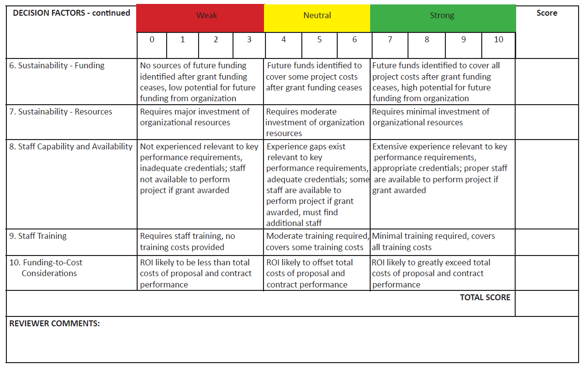
Deciding to Apply or Not: Decision Matrix 2

Slide 12
Breakout Room Discussion
What’s the one thing you wish everyone knew about researching grant opportunities or the decision-making process?

Slide 13
Thoughts? Tips? Questions?

Slide 14
More, More Questions?
Erin Christensen, EdD
Grants Specialist, Oregon State University Precollege Programs
erin.christensen@oregonstate.edu
https://www.linkedin.com/in/erin-christensen-8a8a67193/

